Slide 1
Problem Statement:
Houses are one of the necessary need of each and every person around the globe and therefore housing and real estate market is one of the markets which is one of the major contributors in the world’s economy. It is a very large market and there are various companies working in the domain. Data science comes as a very important tool to solve problems in the domain to help the companies increase their overall revenue, profits, improving their marketing strategies and focusing on changing trends in house sales and purchases. Predictive modelling, Market mix modelling, recommendation systems are some of the machine learning techniques used for achieving the business goals for housing companies. Our problem is related to one such housing company.
A US-based housing company named Surprise Housing has decided to enter the Australian market. The company uses data analytics to purchase houses at a price below their actual values and flip them at a higher price. For the same purpose, the company has collected a data set from the sale of houses in Australia. The data is provided in the CSV file below.
The company is looking at prospective properties to buy houses to enter the market. You are required to build a model using Machine Learning in order to predict the actual value of the prospective properties and decide whether to invest in them or not. For this company wants to know:
• Which variables are important to predict the price of variable?
• How do these variables describe the price of the house?

Slide 2
EDA
STEPS INVOLVED IN EXPLORATORY ANALYSIS: Checking shape of the data set Checking nan values in the each feature by using data.isnull().sum() Finding %of the nan values in each feature Removing features which has more than 90% of the nan values Checking information of the each feature it shows that no of nan null values and dtypes of feature Checking statistical information of the data set Dividing /separate data based on dtype Based on dtype plotting the appropriate plot, if the data is categorical barplot or countplot is better if the data type is continuous distplot is better checking skewness of the continuous features ➔ After removing skewness checking correlation of the features and removing highly correlated features

Slide 3
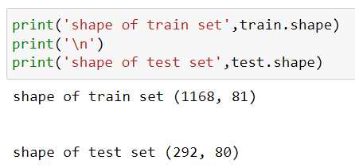
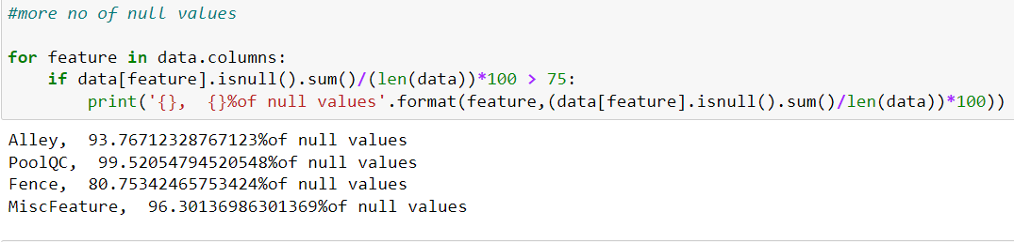
Shape of the data sets(train and test):-
Checking null values:- Null values are present in most of the features so I can extract only features which has more than 75% of null values
I can drop this features from both the sets due to more no of null values

Slide 4
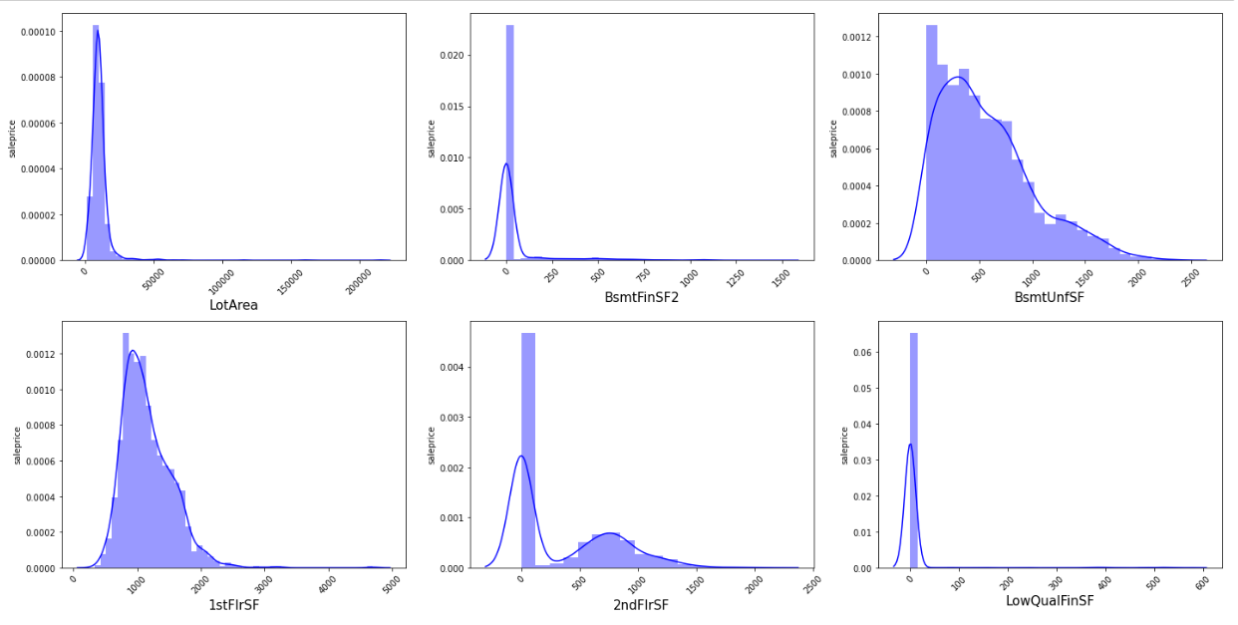

Slide 5
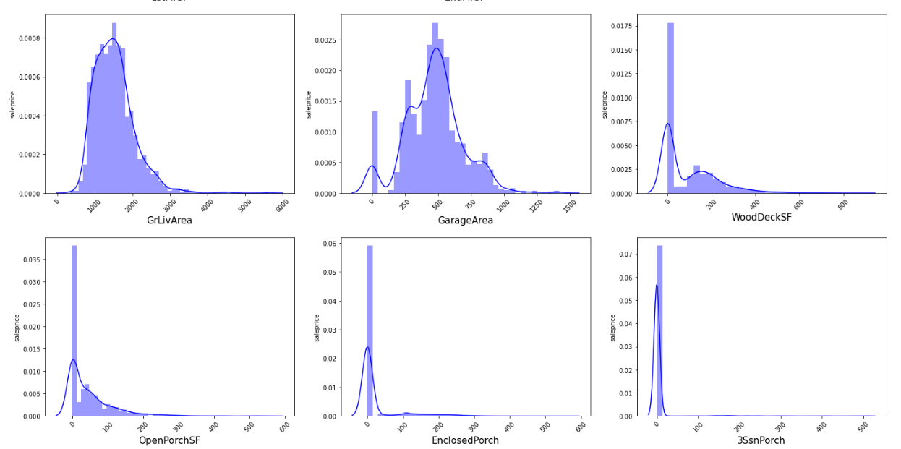
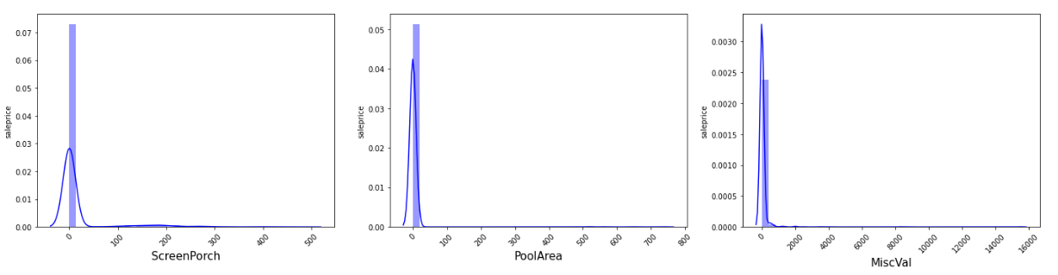
Observation:- we can see that most from all the above plots data is skewed right side

Slide 6
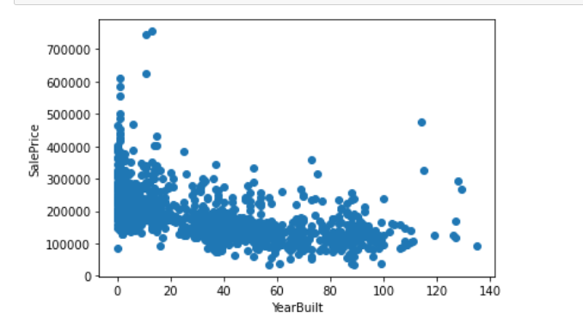
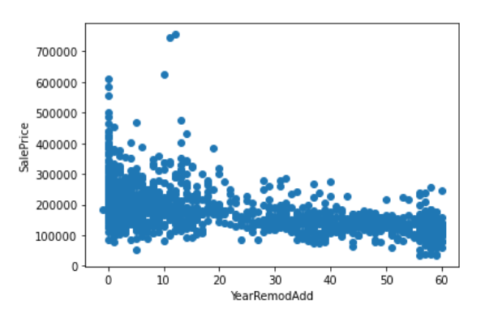
Visualization
Years vs price
Observation:- Increasing of year the price is decreases

Slide 7
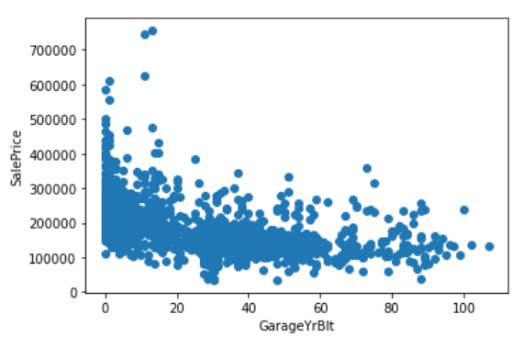
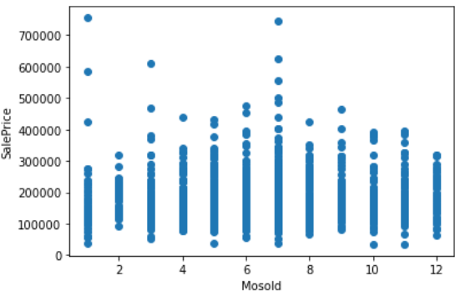
Observation:- ➔Garage price is high when the years is less i.e recent one is high price ➔in the month of 1st and 7th price is high

Slide 8
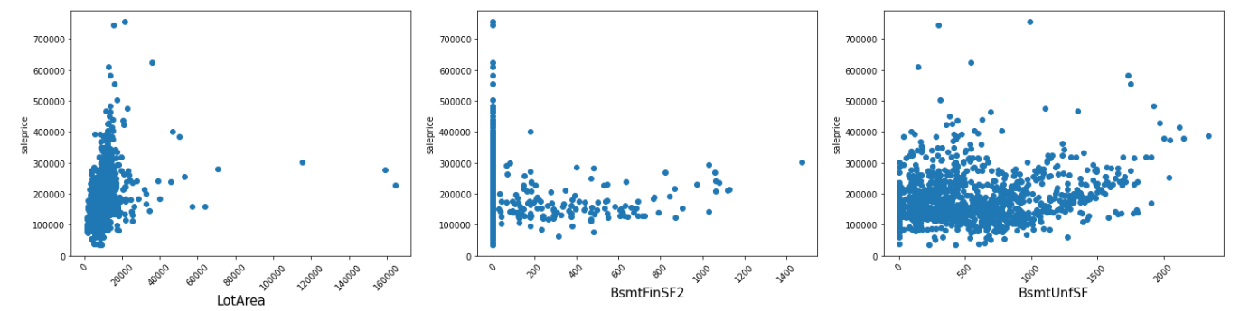
LotArea:- Lotarea is between 0 to 20000 sft price is also high in this area that is If the area is increases price is also increases
BsmtFinSF2:-the price is high in the squarefeet of finished areatype2 is 0 and also price is increases when the area is increases
BsmtUnfSF:- we can see that increasing of area the price is also increases

Slide 9
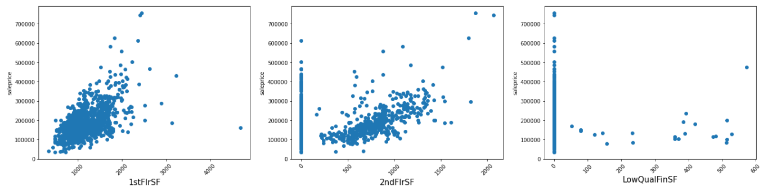

Slide 10
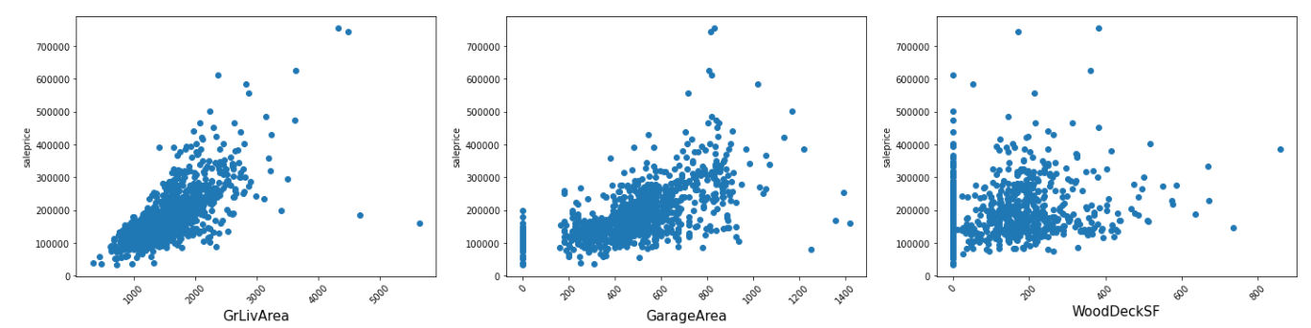
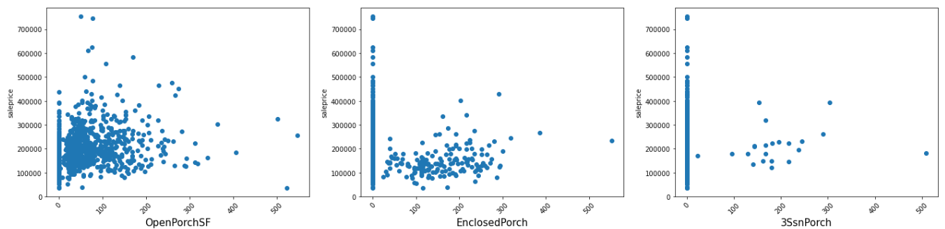
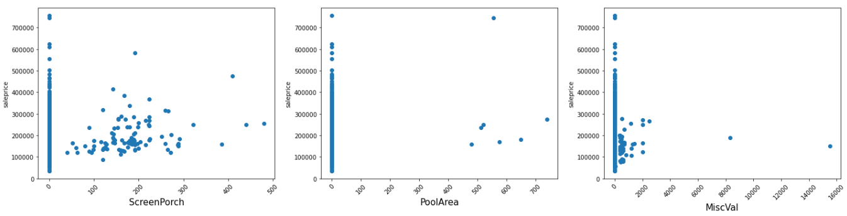
Observation:-
form the above plots we can see that When the area increases the price of the house is increases

Slide 11
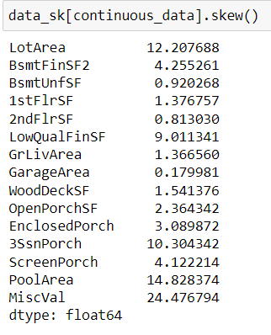
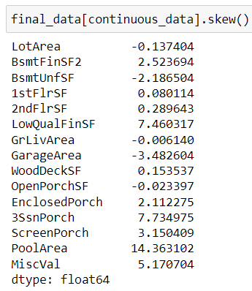
Encoding the categorical data :-
➔In the some of the features are having ordinal data so ordinal encoder is the best way to deal ➔Remaining are encoded by using getdummies
Dealing with skewness
Before applying log transformation
after applying log transformation

Slide 12
Checking correlation of features:- After plotting the heat map I find high correlating features and also drop them some of the features After checking the correlation after that I splitting the data into two sets (train and test)
Splitting data into dependent and independent sets :- ➔after splitting the data we need to scale the data iam using MinMaxScaler to scale the data
Note:- MinMax Scaler shrinks the data in the range of
0 to 1

Slide 13
Model building
Models ued to train and test LinearRegression 2) DecisionTreeRegressor 3) RandomForestRegressor 4) GradientBoostingRegressor 5) XGBRegressor 6) BaggingRegressor
Train and test score and cross validation score 90.8 and 90.7 and CS score is –1.58e^26 100.0 and 100.0 and CS score is 67.6 97.8 and 98.8 and CS score is 83.8 96.7 and 97.2 and CS score is 86.3 100.0 and 100.0 and CS score is 82.3 96.1 and 97.6 and CS score is 81.8

Slide 14
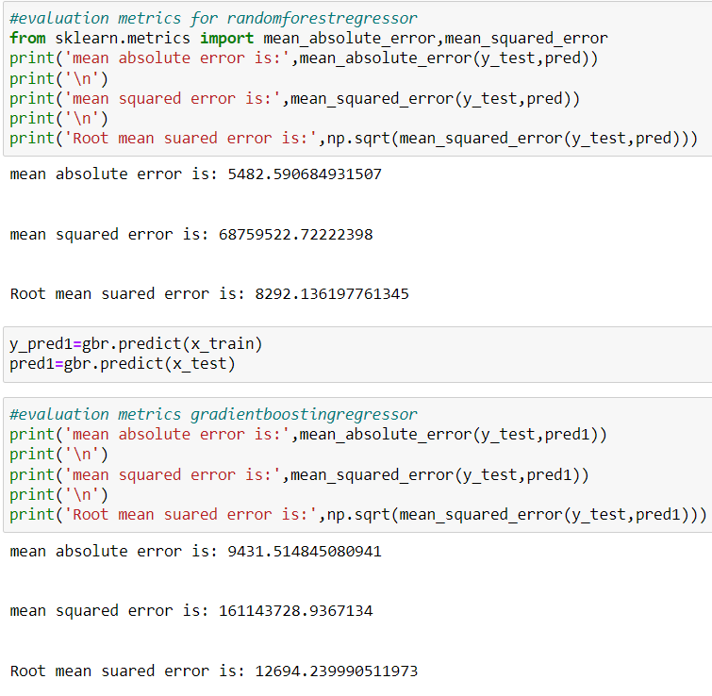
Choosing best model
Two models randomforest and gradientboosting are giving the best score by checking evaluation metrics to choose best model
The error rate is low in the randomforestegressor so rfc is the final model

